Slide 1


Welcome’s You
Into the Final Capstone E-Commerce Project.ppt
Amazon Sentiment Analysis
By- MOHD ZEESHAN

Slide 2
Abstract:
This project focuses on analyzing sentiments expressed in over 34,000 Amazon product reviews within the e-commerce domain, with the goal of predicting sentiment or satisfaction levels based on various features and reviews text. The dataset includes attributes such as name of the product, brand, categories, reviews text, title, and sentiment labels classified into Positive, Negative, and Neutral.
The project first addresses the challenge of class imbalance in sentiment categories by applying techniques like oversampling and under-sampling. It explores multiple machine learning models, starting with a multinomial Naive Bayes classifier, and progressively incorporates advanced techniques like multi-class Support Vector Machines (SVM), neural networks (including Long Short-Term Memory networks), and ensemble methods such as XGBoost. Feature engineering, including the use of Term Frequency-Inverse Document Frequency (Tf-Idf) and sentiment scores, is central to the analysis.
Performance evaluation is conducted using precision, recall, F1-score, and AUC-ROC metrics. The project also investigates topic modeling with techniques like Latent Dirichlet Allocation (LDA) and Non-Negative Matrix Factorization (NMF) to cluster similar reviews based on product features. By comparing traditional machine learning algorithms with neural network approaches, this work aims to develop an accurate and robust sentiment analysis model for e-commerce applications, with practical implications for understanding consumer sentiment in the digital marketplace.

Slide 3
Content:
Introduction
Objectives
Methods
Results
Conclusions
Introduction
This project aims to analyzing sentiments expressed in over 34,000 reviews for Amazon brand products within the e-commerce domain. The dataset contains attributes such as name of the product, brand, categories, reviews titles, reviews text, and sentiment levels categorized into "Positive," "Negative," and "Neutral." The project aims to predict sentiment or satisfaction levels based on various features and reviews text.

Slide 4
Objectives
We are required to predict Sentiment or Satisfaction of a purchase based on multiple features and review text. The key objectives include:
● Understand the sentiment expressed in consumer reviews.
● Address class imbalance in sentiment categories.
● Implement classifiers and advanced techniques for sentiment analysis.
● Evaluate model performance using appropriate metrics.
● Compare traditional machine learning algorithms with neural network approaches.
● Explore topic modeling techniques for clustering similar reviews.

Slide 5
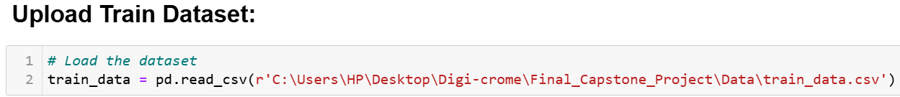
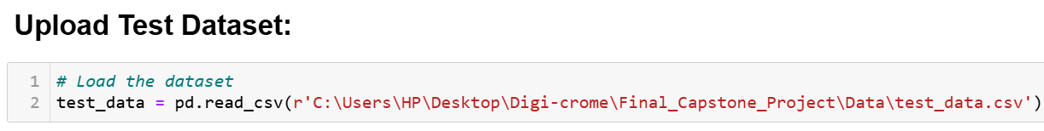
Methods
(i). Load the Datasets:
To load the E-commerce dataset into a Pandas DataFrame, Load the dataset provided in a CSV or Excel format into a Pandas DataFrame to facilitate easy manipulation and analysis. Using Python Pandas Library.

Slide 6
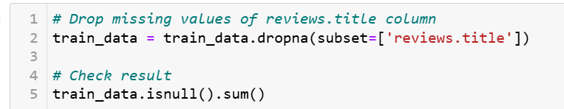
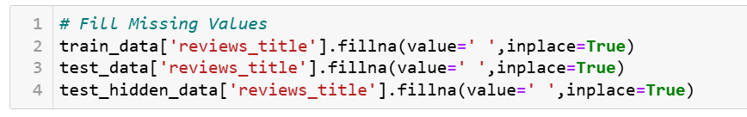
(ii). Cleaned the Datasets:
Cleaning the data is an essential step in the data analysis process. It involves preparing the dataset by addressing missing values, removing duplicate entries, and fixing any anomalies or inconsistencies. This ensures that the data is accurate and reliable for further analysis.
Handling Missing Values

Slide 7



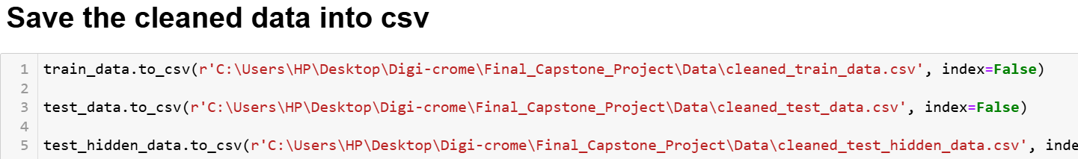

Slide 8
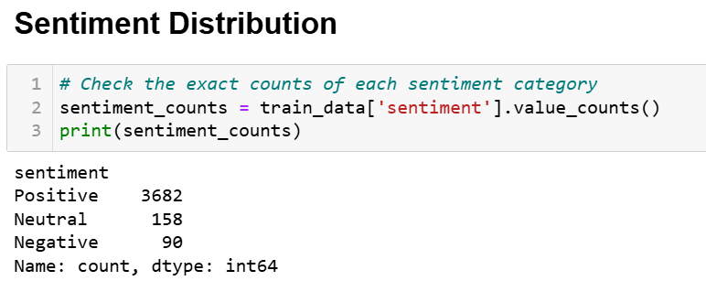
Exploratory Data Analysis :
Here’s a step-by-step guide on performing Exploratory Data Analysis (EDA) to identify important features that visualize distribution of sentiment categories and investigate trends or patterns in the dataset:

Slide 9
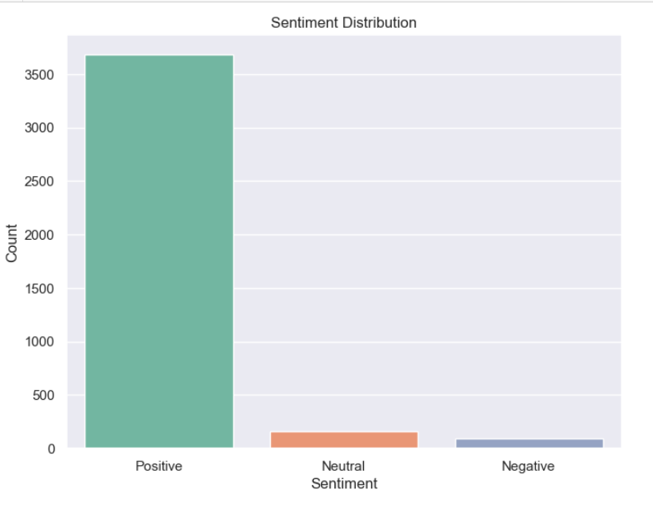

Slide 10
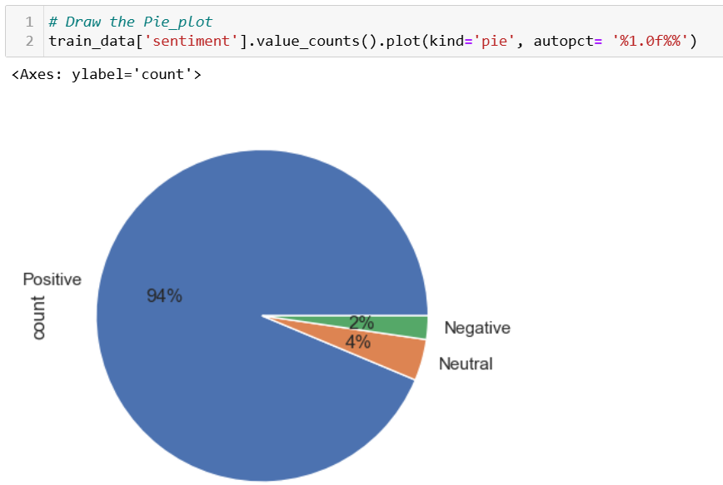

Slide 11
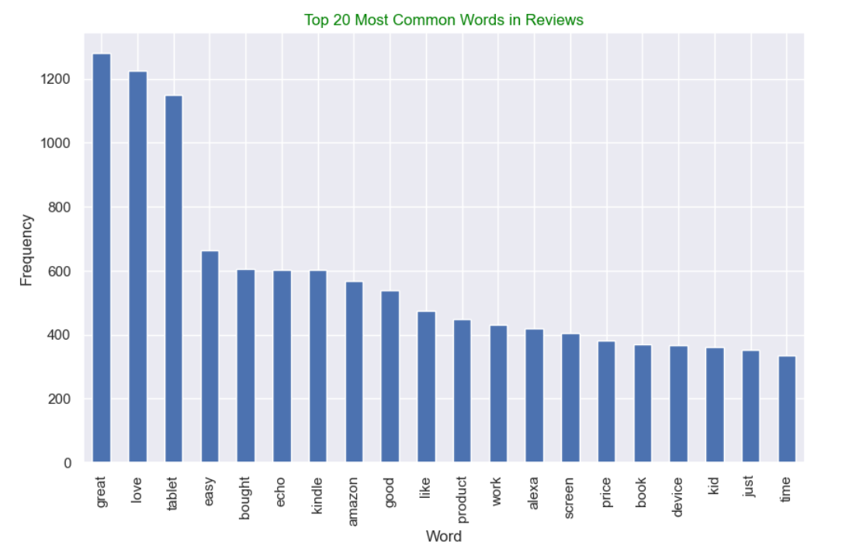

Slide 12
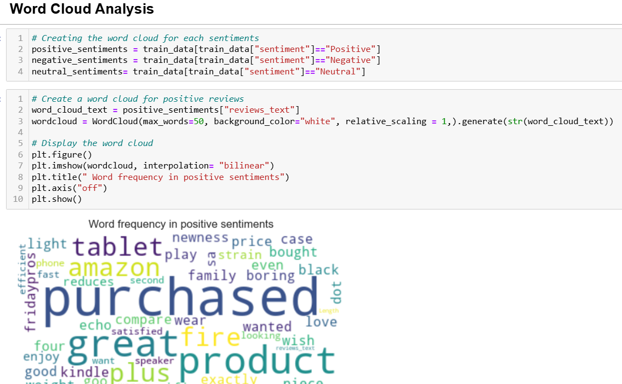

Slide 13
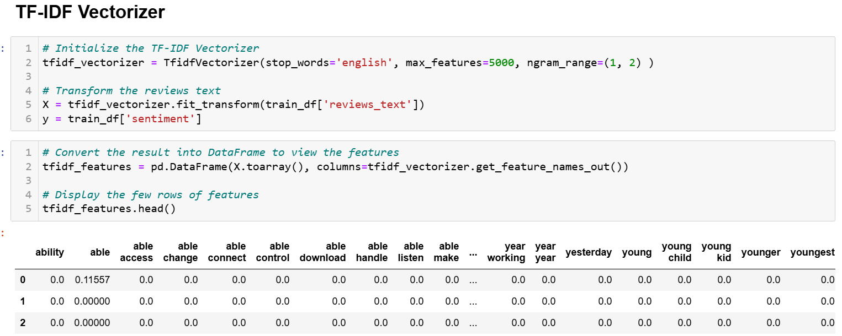
Feature Engineering:
After identifying and visualizing the sentiment features, transforms the review text into numerical features that can be used by machine learning algorithms.

Slide 14
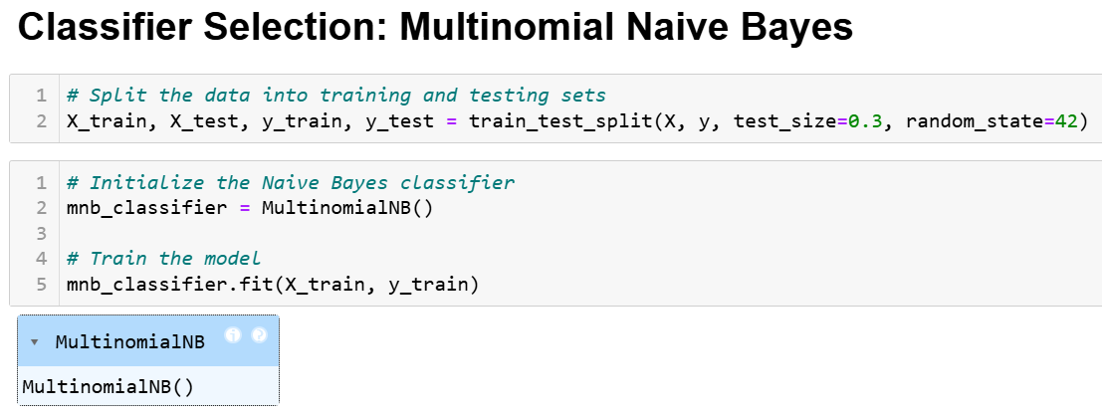
Classifier Selection:
Naive Bayes Classifier - A simple and efficient model for text classification, it Works well with text data and categorical features.

Slide 15
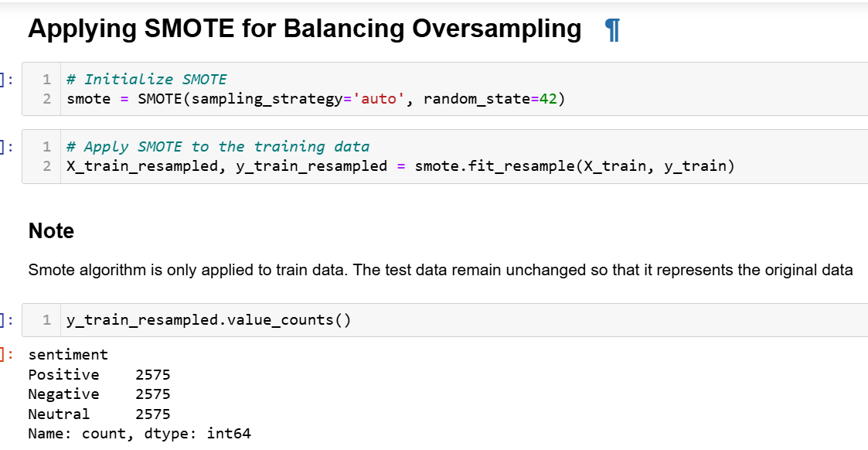
Tackling Class Imbalance:
Oversampling or under-sampling can be used to tackle the class imbalance problem. In case of class imbalance criteria, use the following metrices for evaluating model performance: precision, recall, F1-score, AUC-ROC curve. Use F1-Score as the evaluation criteria for this project.

Slide 16
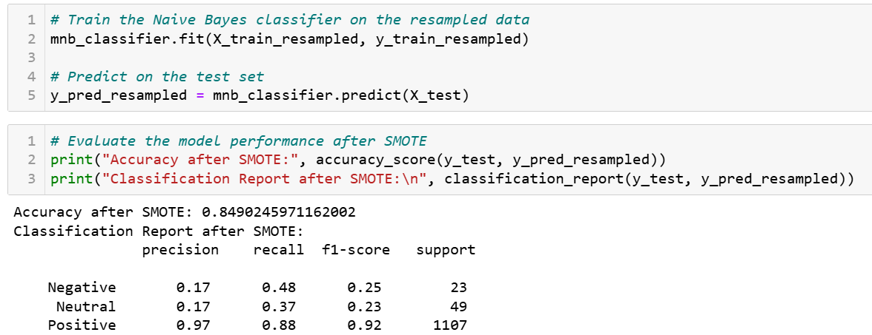

Slide 17
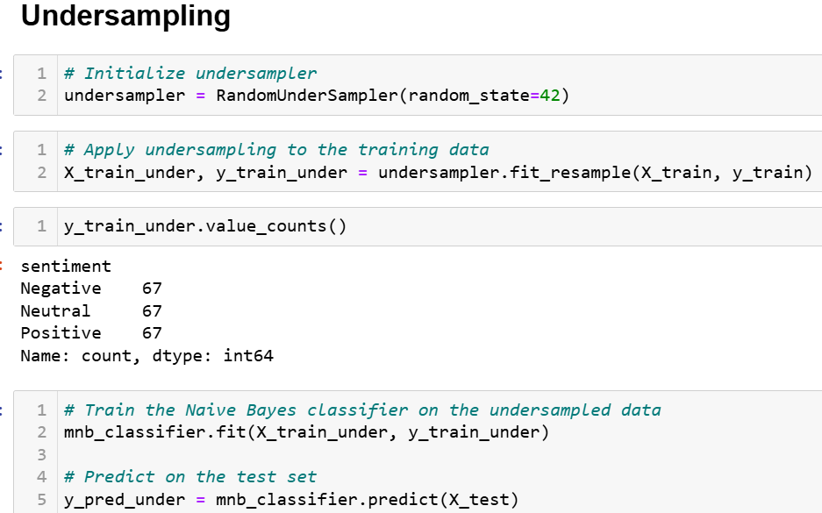

Slide 18
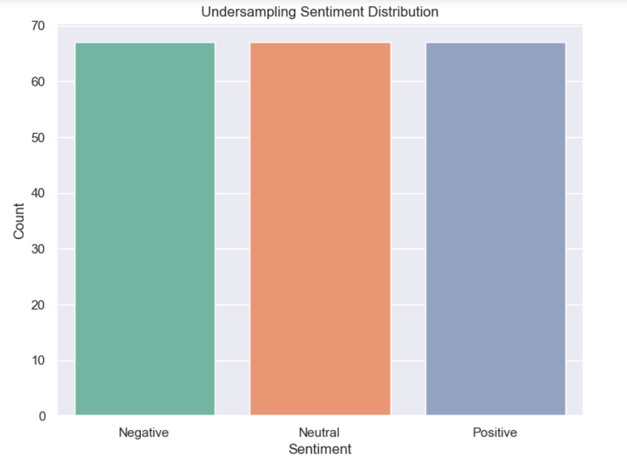

Slide 19
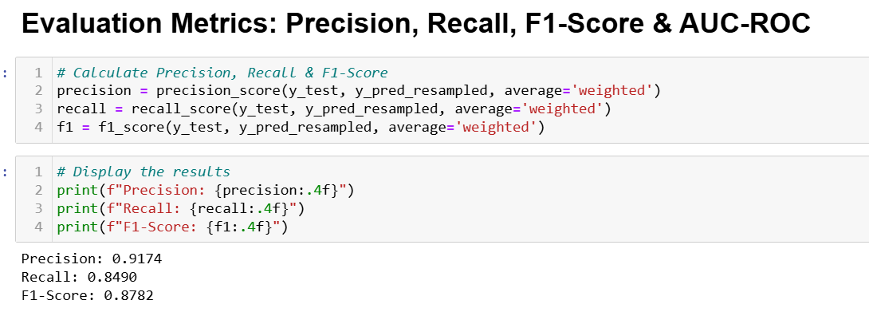

Slide 20
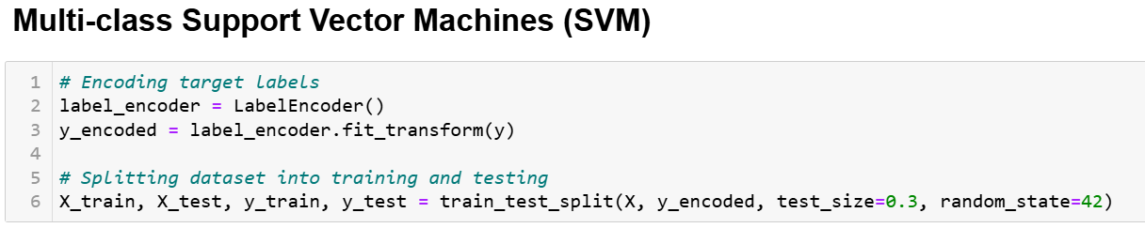
Model Selection and Advanced Techniques
In this weeks, advanced models like multi-class SVMs and neural networks (including deep learning) will be implemented for sentiment analysis, leveraging their ability to capture complex patterns. Ensemble methods, such as XGBoost with oversampled Naive Bayes, will be explored to improve performance and address class imbalance. Feature engineering, including a sentiment score, will enhance model accuracy. Additionally, LSTM networks will be applied to capture long-term dependencies in text data, with parameter tuning for optimization. The models will be compared to traditional machine learning approaches to identify the best-performing architecture. Topic modeling techniques like LDA and NMF will be used to cluster reviews based on aspects such as device features, aesthetics, and performance, identifying latent topics within the reviews.

Slide 21
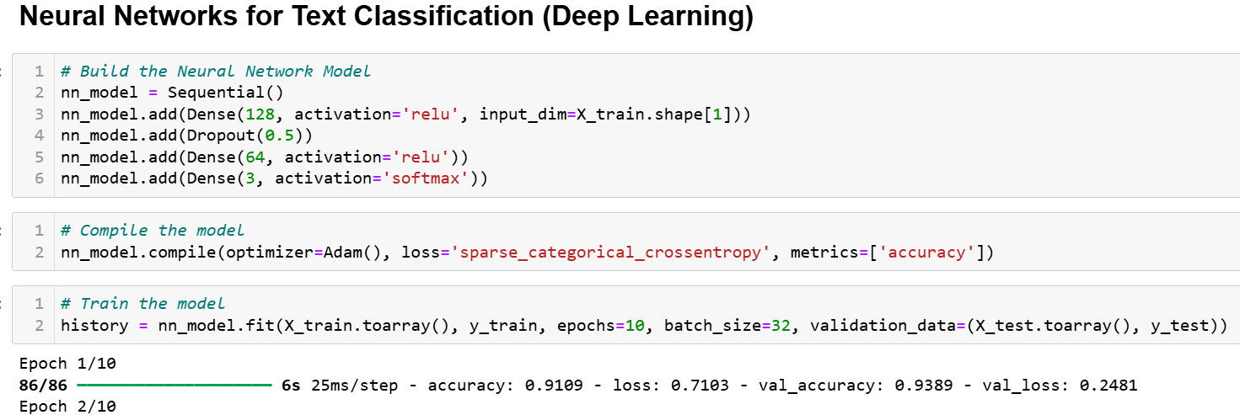

Slide 22
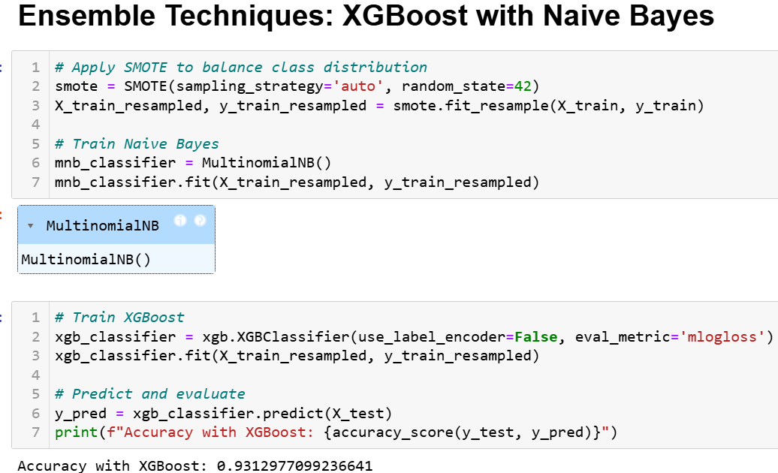

Slide 23
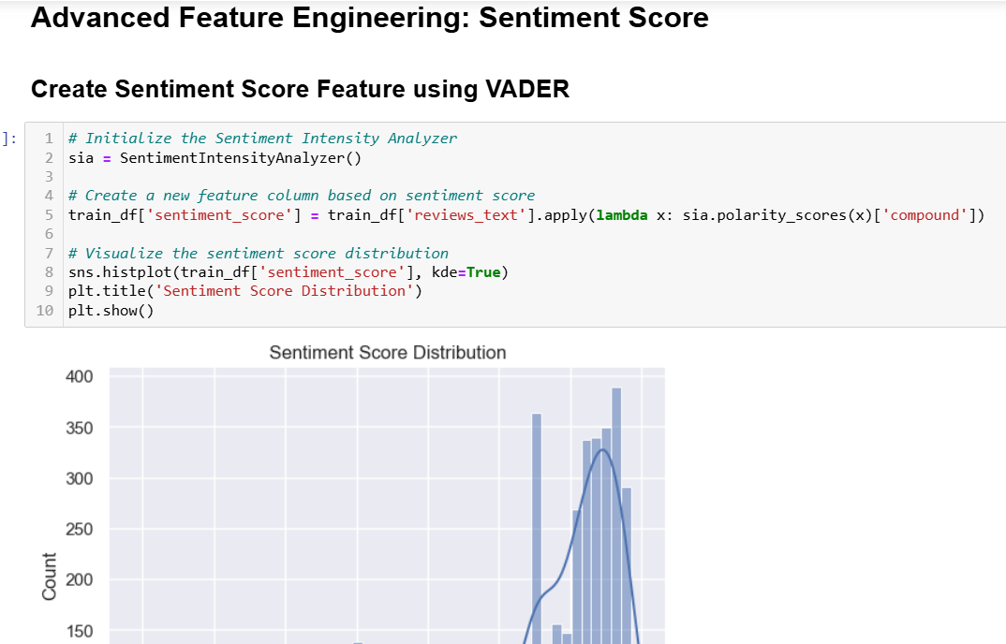

Slide 24
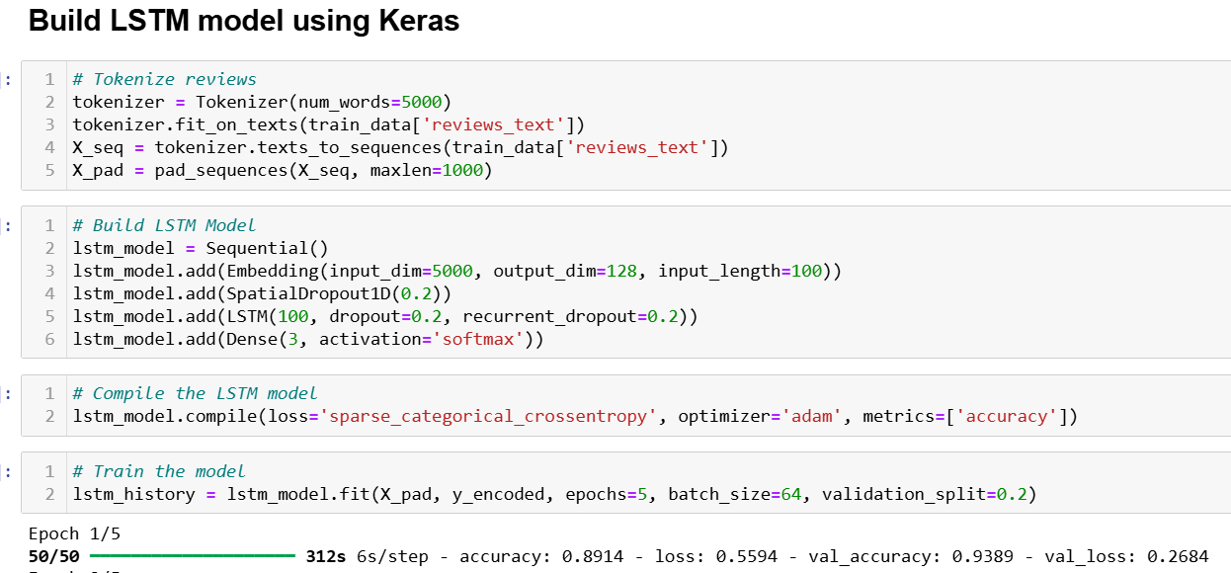

Slide 25
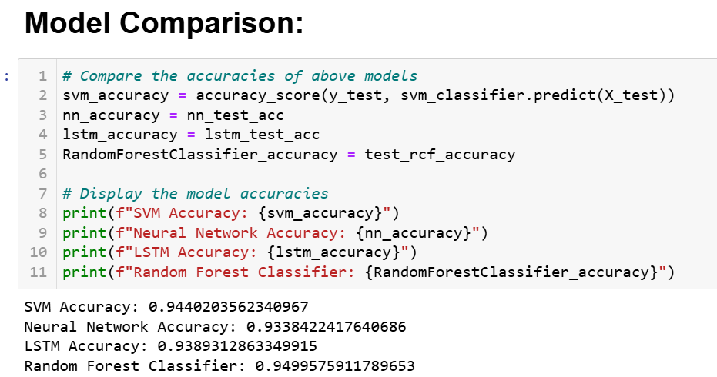

Slide 26
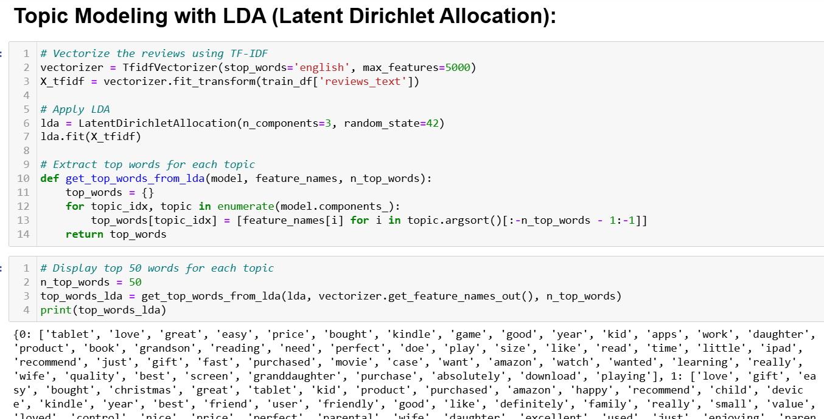

Slide 27
Results
Sentiment Distribution:
Imbalance: 94% Positive, 2% Negative, 4% Neutral
Impact: Class imbalance addressed using oversampling and under-sampling techniques.
Model Performance Evaluation:
Multinomial Naive Bayes: Initial benchmark
SVM & Neural Networks: Significant improvement in F1-score and accuracy
LSTM Model: Improving sentiment prediction accuracy
Metrics: Precision, Recall, F1-Score, AUC-ROC used for model comparison
Visuals/Graphs:
Bar/Pie charts: To show sentiment distribution and class imbalance.
Confusion Matrices: To visually compare model predictions vs actual sentiments.
ROC Curve: To highlight AUC-ROC score comparison across models.
Precision-Recall Graphs: For evaluating class-specific performance.
Word Cloud or Feature Importance: To display key words or features identified in sentiment
analysis or topic modeling.

Slide 28


Conclusions
This project aims to developed an accurate and robust sentiment analysis model for Amazon product reviews, addressing the class imbalance problem, selecting appropriate classifiers, and exploring advanced modeling techniques. Insights gained from the project will contribute to the understanding of sentiment analysis methodologies and their applications in real-world scenarios.

